Slide 1
IPL Dashboard
Neeraj Negi

Slide 2
IPL Analysis
Now that this year's IPL is over, let's not curb our cricket love and start analysing the whole of IPL with this latest and complete Indian Premier League dataset. It contains the match descriptions, results, winners, player of the matches, ball by ball dataset and much more. So, stop thinking and start analyzing

Slide 3
Aim
To analyze Data
To find anomalies
To preprocess data
To cleanse the data
To provide the insights on data with different visualization

Slide 4
Case
To provide detailed insight on IPL in various dimensions like
Date/month/year
Venue wise
Player wise
Team wise

Slide 5
Audience
Franchise Owners
Talent Management Companies
Marketing companies
Fantasy Apps Companies

Slide 6
Nature of Data
We have IPL Data from 2008-20
Match wise Details
Ball by Ball detailed data of each match 2008-20
Around 192879 records ,mainly 5 categories , few discrepancies detected like (null values , duplicate values , around 9 numerical variables which are contentious

Slide 7
Bowlers performance(yoy)

Slide 8
Team wise innings performance

Slide 9
% of mode of dismissal

Slide 10
Batsman performance (yoy)

Slide 11
TOP 10 Batsman with highest Strike Rate

Slide 12
TOP 10 BATSMAN - BOUNDARY
PLAYERS WITH HIGHEST FOUR’S
PLAYERS WITH HIGHEST SIX’S

Slide 13
TOP 10 BOWLERS AND BATSMAN
TOP 10 RUN SCORER’S
TOP 10 WICKET TAKER’S

Slide 14
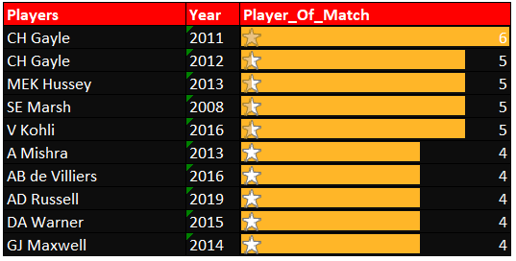
TOTAL MAN OF THE MATCH AWARDS
TOP 10 MOM AWARDS
BATSMAN WITH MOST NO OF MOM IN A YEAR

Slide 15
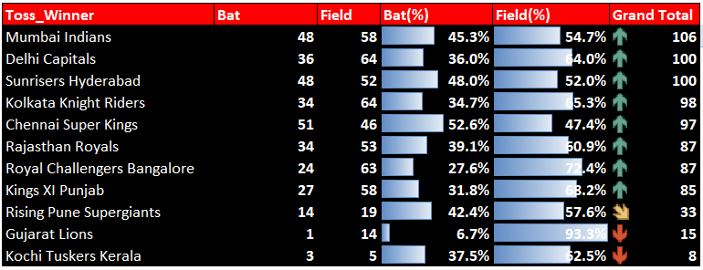
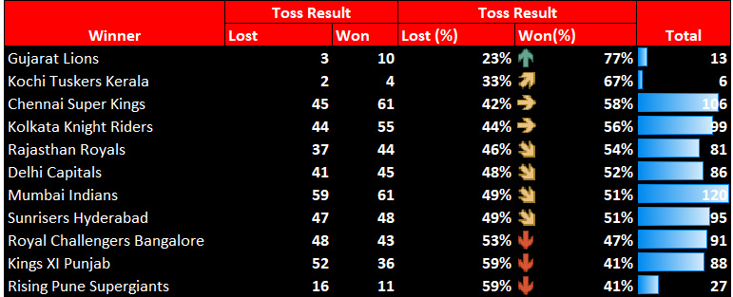
TOSS AND WINING % ANALYSIS
Team’s toss win % and match wining %
Team's having highest win % when lossing toss

